Slide 2
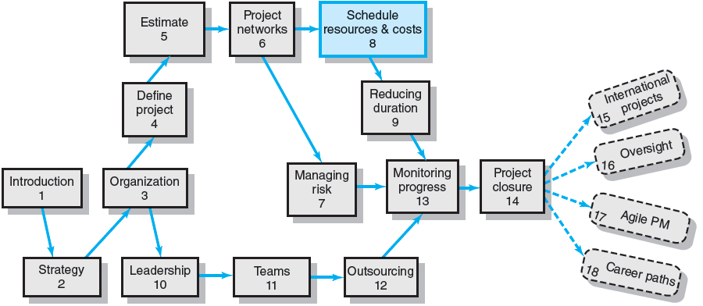
Where We Are Now

Slide 3
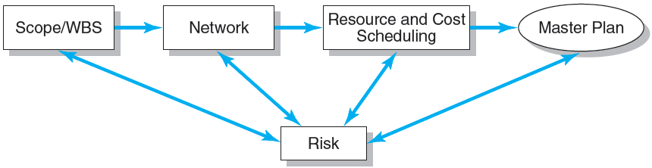
Project Planning Process
FIGURE 8.1

Slide 4
Resources and Priorities
Project network times are not a schedule until resources have been assigned.
The implicit assumption is that resources will be available in the required amounts when needed.
Adding new projects requires making realistic judgments of resource availability and project durations.
Cost estimates are not a budget until they have been time-phased.

Slide 5
Overview of the Resource Scheduling Problem
Will the assigned labor and/or equipment be adequate and available to deal with my project?
Will outside contractors have to be used?
Do unforeseen resource dependencies exist? Is there a new critical path?
How much flexibility do we have in using resources?
Is the original deadline realistic?

Slide 6
The Resource Problem (cont’d)
Resource Smoothing (or Leveling)
Involves attempting to even out varying demands on resources by using slack (delaying noncritical activities) to manage resource utilization when resources are adequate over the life of the project.
Resource-Constrained Scheduling
The duration of a project may be increased by delaying the late start of some of its activities if resources are not adequate to meet peak demands.

Slide 7
Types of Project Constraints
Technical or Logic Constraints
Constraints related to the networked sequence in which project activities must occur.
Physical Constraints
Activities that cannot occur in parallel or are affected by contractual or environmental conditions.
Resource Constraints
The absence, shortage, or unique interrelationship and interaction characteristics of resources that require a particular sequencing of project activities

Slide 8
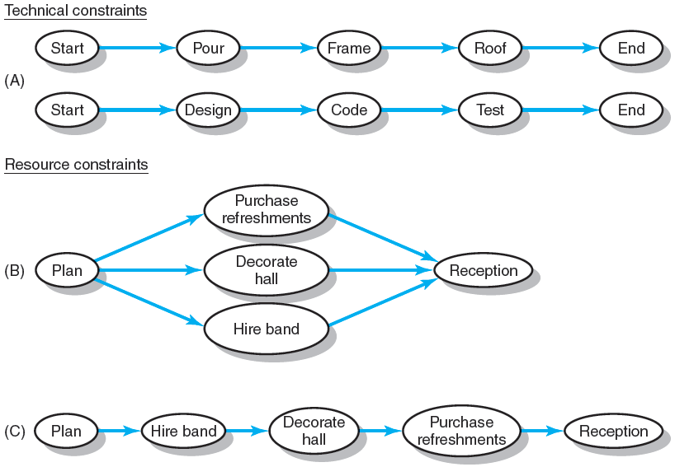
Constraint Examples
FIGURE 8.2

Slide 9
Types of Resource Constraints
People
This is the most obvious and important project resource.
Human resources are usually classified by the skills they bring to the project
Materials
Project materials cover a large spectrum
Material availability and shortages have been blamed for the delay of many projects.
Equipment
Equipment is usually presented by type, size, and quantity

Slide 10
Classification of a Scheduling Problem
Classification of Problem
Using a priority matrix will help determine if the project is time or resource constrained.
Time-Constrained Project
Must be completed by an imposed date.
Time is fixed, resources are flexible: additional resources are required to ensure project meets schedule.
Resource-Constrained Project
Is one in which the level of resources available cannot be exceeded.
Resources are fixed, time is flexible: inadequate resources will delay the project.

Slide 11
Resource Allocation Methods
Limiting Assumptions
Splitting activities is not allowed—once an activity is start, it is carried to completion.
Level of resources used for an activity cannot be changed.
Risk Assumptions
Activities with the most slack pose the least risk.
Reduction of flexibility does not increase risk.
The nature of an activity (easy, complex) doesn’t increase risk.

Slide 12
Resource Allocation Methods (cont’d)
Time-Constrained Projects
Must be completed by an imposed date.
Require use of leveling techniques that focus on balancing or smoothing resource demands.
Use positive slack (delaying noncritical activities) to manage resource utilization over the duration of the project.
Peak resource demands are reduced.
Resources over the life of the project are reduced.
Fluctuation in resource demand is minimized.

Slide 13
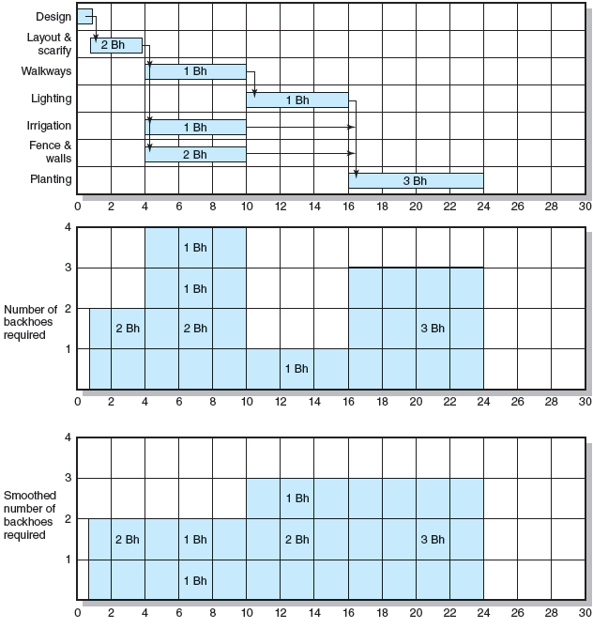
Botanical Garden
FIGURE 8.3

Slide 14
Resource Allocation Methods (cont’d)
Resource Demand Leveling Techniques for Time-Constrained Projects
Advantages
Peak resource demands are reduced.
Resources over the life of the project are reduced.
Fluctuation in resource demand is minimized.
Disadvantages
Loss of flexibility that occurs from reducing slack.
Increases in the criticality of all activities.

Slide 15
Resource Allocation Methods (cont’d)
Resource-Constrained Projects
Resources are limited in quantity or availability.
Activities are scheduled using heuristics (rules-of-thumb) that focus on:
Minimum slack
Smallest (least) duration
Lowest activity identification number
The parallel method is used to apply heuristics
An iterative process starting at the first time period of the project and scheduling period-by-period the start of any activities using the three priority rules.

Slide 16
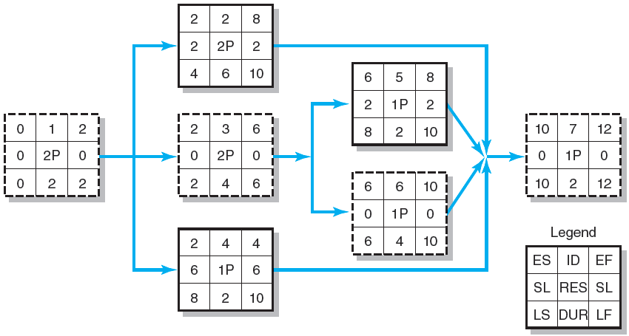
Resource-Constrained Schedule through Period 2–3
FIGURE 8.4

Slide 17
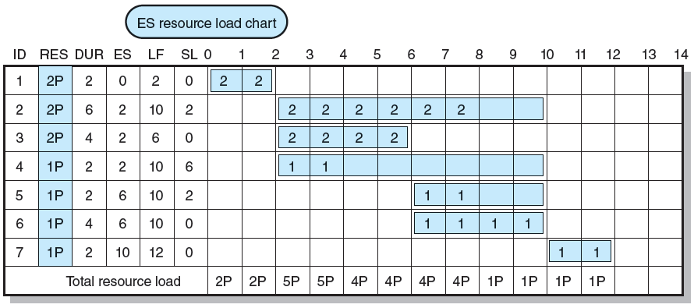
Resource-Constrained Schedule through Period 2–3
FIGURE 8.4 (cont’d)

Slide 18
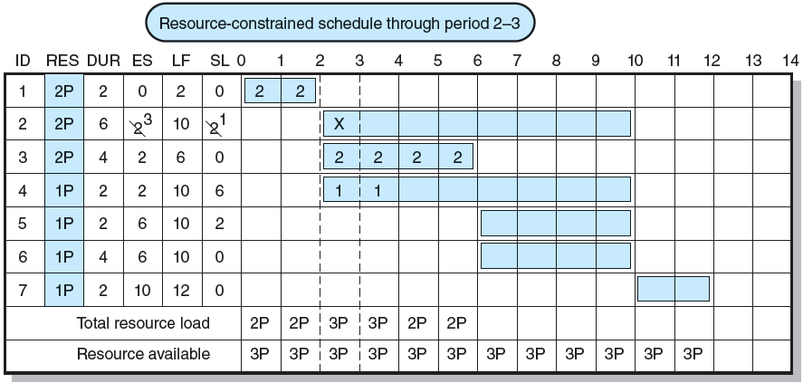
Resource-Constrained Schedule through Period 2–3
FIGURE 8.4 (cont’d)

Slide 19
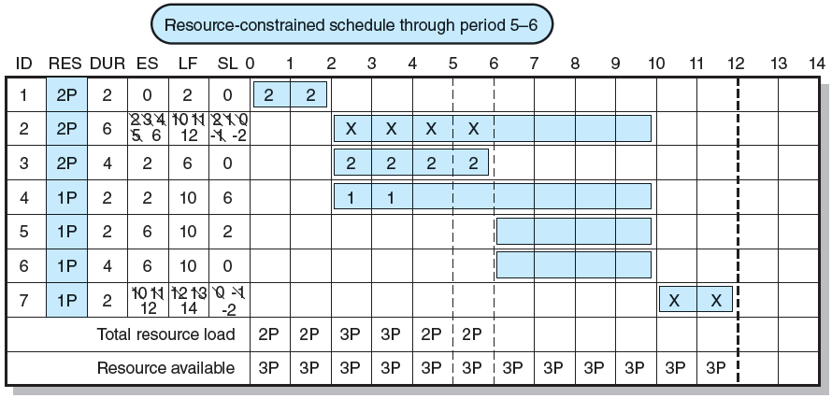
Resource-Constrained Schedule through Period 5–6
FIGURE 8.5

Slide 20
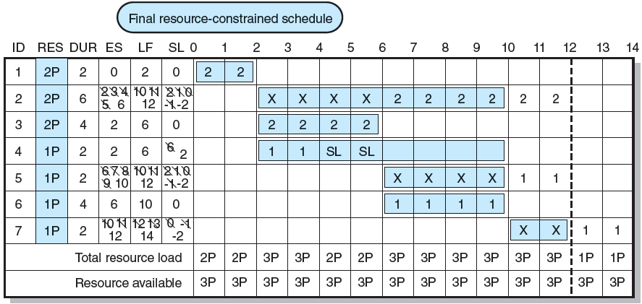
Resource-Constrained Schedule through Period 5–6
FIGURE 8.5 (cont’d)

Slide 21
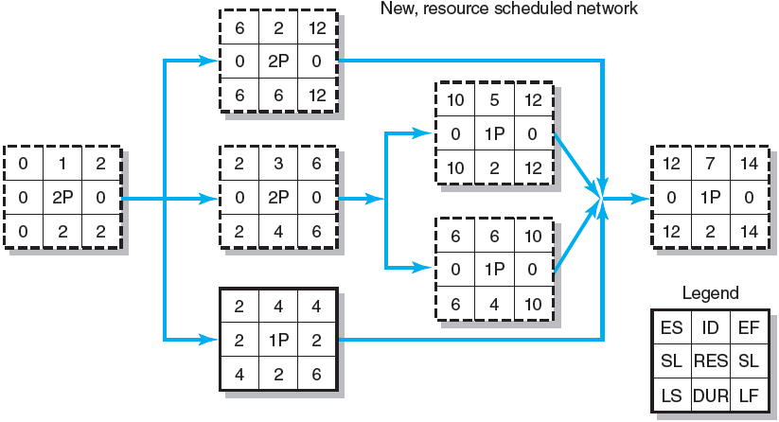
Resource-Constrained Schedule through Period 5–6
FIGURE 8.5 (cont’d)

Slide 22
Computer Demonstration of Resource-Constrained Scheduling
EMR Project
The development of a handheld electronic medical reference guide to be used by emergency medical technicians and paramedics.
Problem
There are only eight design engineers who can be assigned to the project due to a shortage of design engineers and commitments to other projects.

Slide 23
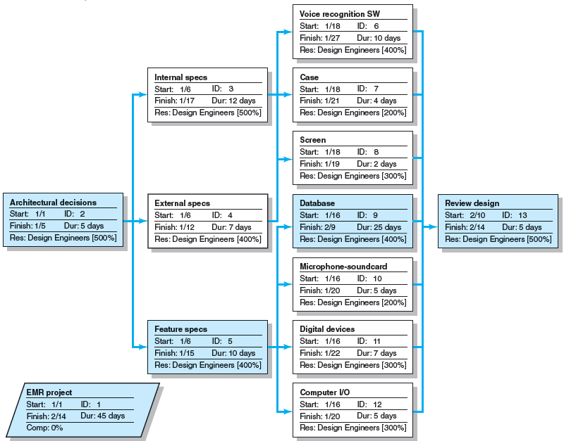
EMR Project: Network View Schedule before Resources Leveled
FIGURE 8.6

Slide 24
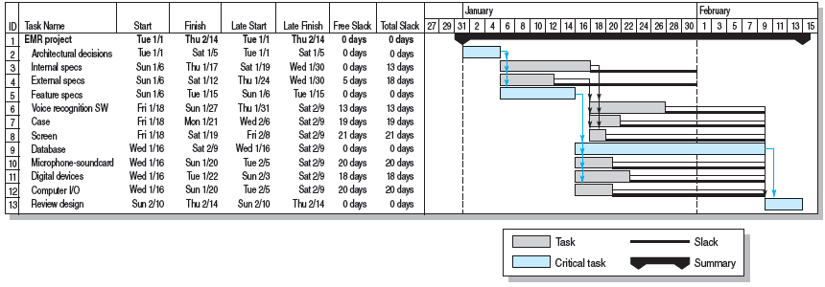
EMR Project before Resources Added
FIGURE 8.7

Slide 25
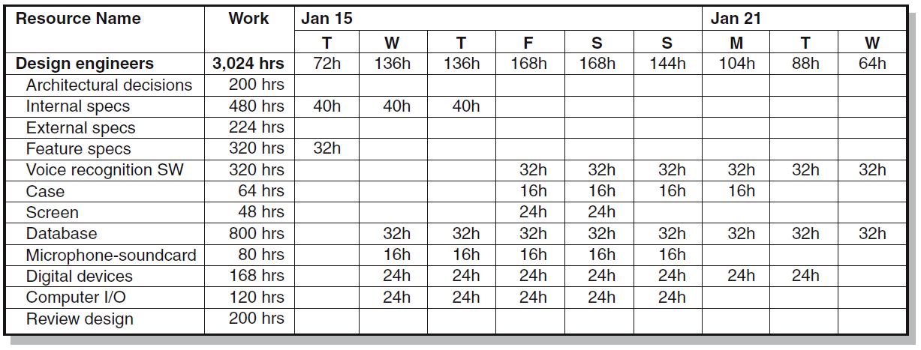
EMR Project—Time Constrained Resource Usage View, January 15–23
FIGURE 8.8A

Slide 26
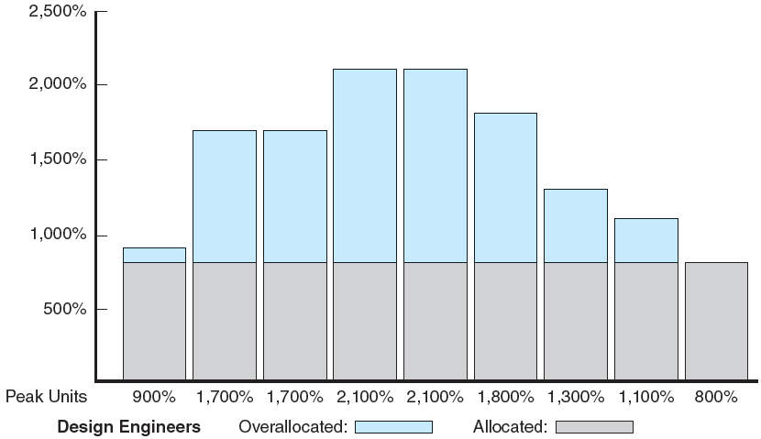
Resource Loading Chart for EMR Project, January 15–23
FIGURE 8.8B

Slide 27
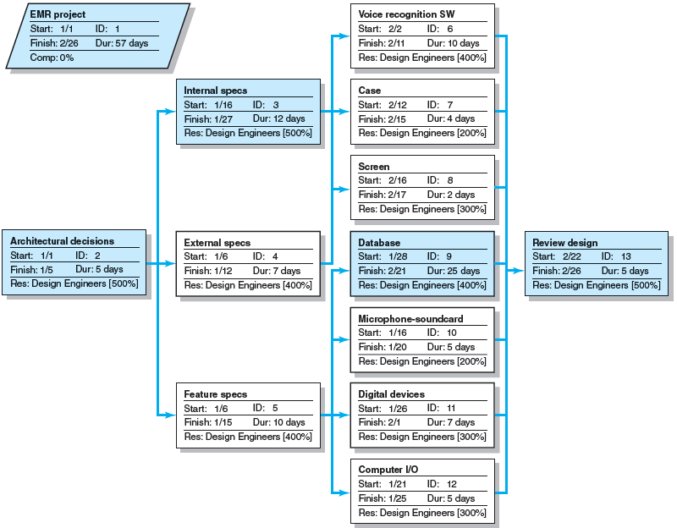
EMR Project Network View Schedule after Resources Leveled
FIGURE 8.9

Slide 28
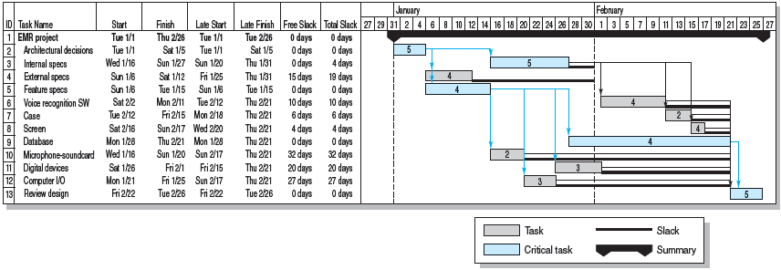
EMR Project Resources Leveled
FIGURE 8.10

Slide 29
The Impacts of Resource-Constrained Scheduling
Reduces delay but reduces flexibility.
Increases criticality of events.
Increases scheduling complexity.
May make the traditional critical path no longer meaningful.
Can break sequence of events.
May cause parallel activities to become sequential and critical activities with slack to become noncritical.

Slide 30
Splitting
Splitting
A scheduling technique for creating a better project schedule and/or increase resource utilization.
Involves interrupting work on an activity to employ the resource on another activity, then returning the resource to finish the interrupted work.
Is feasible when startup and shutdown costs are low.
Is considered the major reason why projects fail to meet schedule.

Slide 31
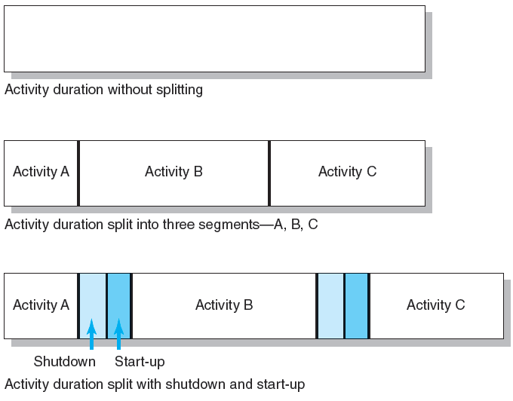
Splitting Activities
FIGURE 8.11

Slide 32
Benefits of Scheduling Resources
Leaves time for consideration of reasonable alternatives:
Cost-time tradeoffs
Changes in priorities
Provides information for time-phased work package budgets to assess:
Impact of unforeseen events
Amount of flexibility in available resources

Slide 33
Multiproject Resource Schedules
Multiproject Scheduling Problems
Overall project slippage
Delay on one project create delays for other projects.
Inefficient resource application
The peaks and valleys of resource demands create scheduling problems and delays for projects.
Resource bottlenecks
Shortages of critical resources required for multiple projects cause delays and schedule extensions.

Slide 34
Multiproject Resource Schedules (cont’d)
Managing Multiproject Scheduling:
Create project offices or departments to oversee the scheduling of resources across projects.
Use a project priority queuing system: first come, first served for resources.
Centralize project management: treat all projects as a part of a “megaproject.”
Outsource projects to reduce the number of projects handled internally.

Slide 35
Using the Resource Schedule to Develop a Project Cost Baseline
Why a Time-Phased Budget Baseline Is Needed
To determine if the project is on, ahead, or behind schedule and over or under its budgeted costs?
To know how much work has been accomplished for the allocated money spent—the project cost baseline (planned value, PV)
Creating a Time-Phased Budget
Assign each work package to one responsible person or department and deliverable.
Compare planned schedule and costs using an integrative system called earned value.

Slide 36
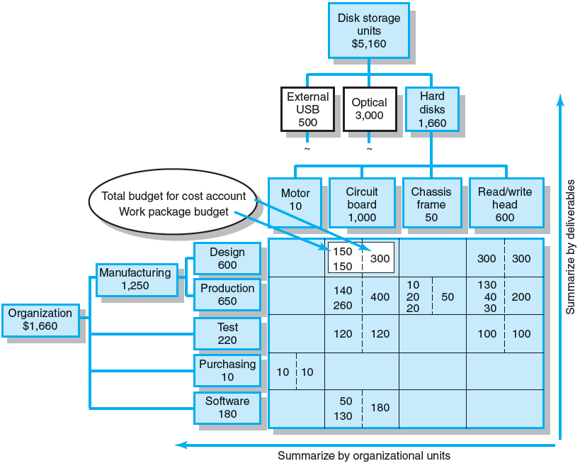
Direct Labor Budget Rollup ($000)
FIGURE 8.12

Slide 37
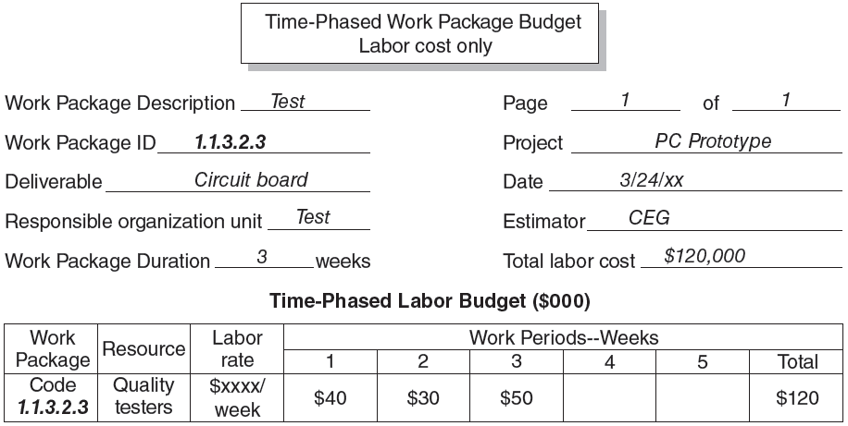
Time-Phased Work Package Budget (Labor Cost Only)
FIGURE 8.13

Slide 38
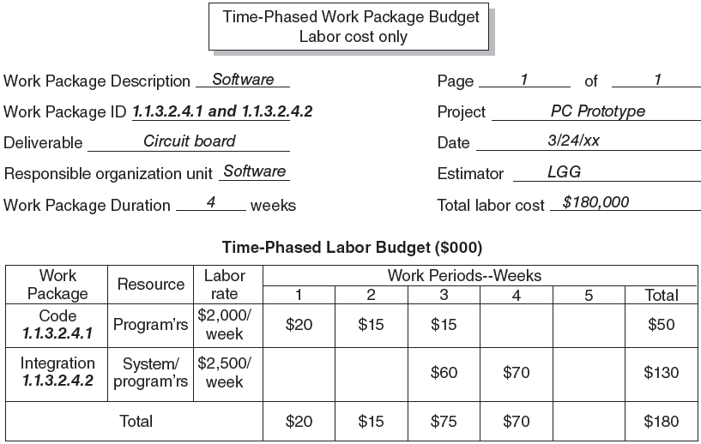
Two Time-Phased Work Packages (Labor Cost Only)
FIGURE 8.14

Slide 39
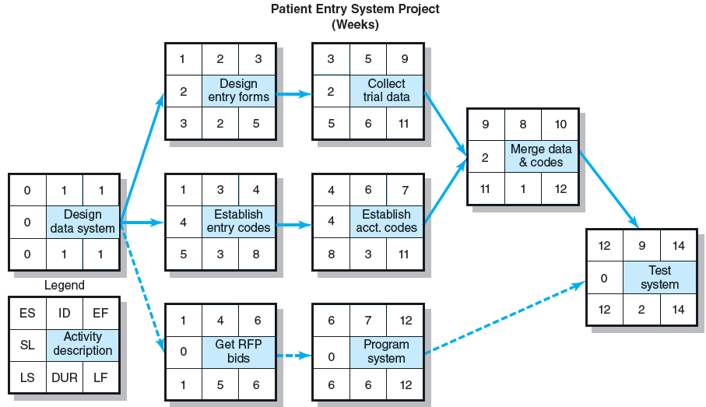
Patient Entry Project Network
FIGURE 8.15

Slide 40
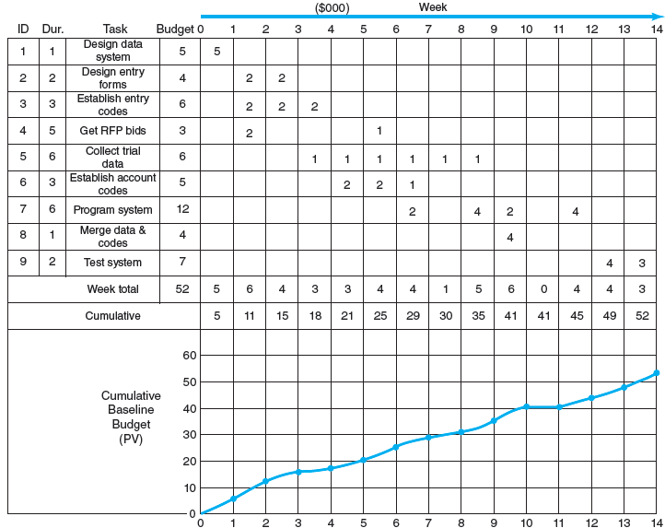
Patient Entry Time-Phased Work Packages Assigned
FIGURE 8.16

Slide 41
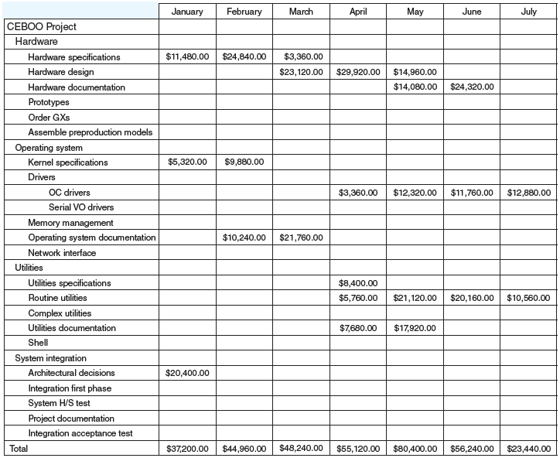
CEBOO Project Monthly Cash Flow Statement
FIGURE 8.17

Slide 42
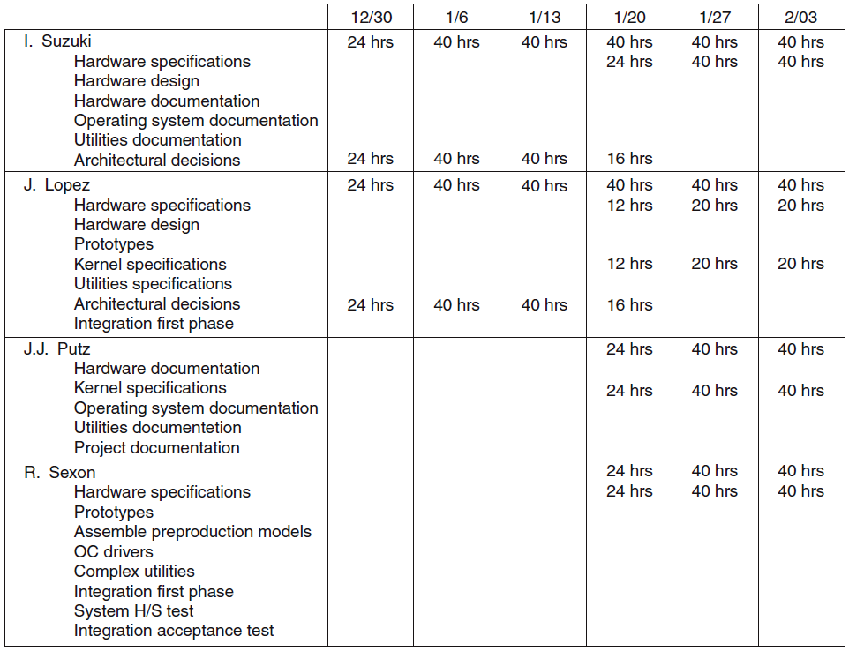
CEBOO Project Weekly Resource Usage Schedule
FIGURE 8.18

Slide 43
Key Terms
Heuristic
Leveling
Planned value (PV)
Resource-constrained projects
Resource smoothing
Splitting
Time-constrained projects
Time-phased budget baseline

